Slide 1
Handling Temporal Characteristics of Data in Sequential Modelling
Kolloquium
Seema More

Slide 2
Table of Content
Introduction
Research Questions
Datasets
Methodology
Results
Summary
Future Research

Slide 3
1. Introduction
Static Data
The data that does not change frequently or remains constant over time
e.g. address, name, phone number
Dynamic Data
The data that changes over time
e.g. temperature, sales of products, heart rate
Combining these two characteristics of data and see the performance of sequential model
Notes:
Static data – is constant. Dynamic data is changing over time time could be hours, week or month…..BREATH AND SLOW, The research questions are…

Slide 4
2. Research Questions
What are the best practices for preprocessing and integrating static and dynamic data in machine learning models to maximize sequential model performance?
How does the number of static and dynamic features in the dataset impact the performance of hybrid models?
Is there a need for using different strategies for integrating static and dynamic data for specific characteristics of datasets?

Slide 5
3. Datasets Vodafone retail shops
source: Vodafone internal
information of different shops of Vodafone in Germany.
162 features, 110 used for implementation after removing columns which contains more null values than 75%.
Monthly dataset from June 2017 to April 2022.
Target column is inflow_mobile which contains the values of sales of mobile phones from 3 different types of Vodafone shops, either partner_shop, own_shop, indirect_shop.
Notes:
Now the datasets, The dataset contains the features like sales of cable connections, then longitude, latitude, city location. SLOW AND BREATH, the second dataset is..

Slide 6
3. Datasets Precipitation
source: kaggle.com
meteorological and soil data
Weather related information among regions of the U.S.
54 features, original target column dropped then 53 features used for implementation.
New target column is PRECTOT which represents the percentage of precipitation in various U.S. regions.
Daily dataset from 2000 to 2020. Data from year 2000 to 2016 used.
Notes:
Original dataset has score as target column that contains the drought level from 0 to 6 but as i am working on regression task, the new target column is selected as PRECTOT. And resource limitationsSLOW AND BREATH, The methodology is

Slide 7
4. Methodology Base Model
Two models used as a base model
SEQUENTIAL
Keras sequential model with dense layers
Keras sequential model has 3 input layers of neurons 64,32,16
LSTM
model with windowing technique.
Vodafone: window_size = 3
precipitation : window_size = 7
Two LSTM input layers of neurons 64 and 32.
Relu as an activation function
Adam as an optimizer

Slide 8
4. Methodology First Method : Using Autoencoder
The dynamic features fed into auto encoder with embedding size of 8.
The Encoder transform the given input vector into lower dimension space of 8 and decoder tried to reconstruct the data as closely as possible to input vector.
Train
Validation
Test
static
dynamic
static
dynamic
static
dynamic
Autoencoder
Autoencoder
Autoencoder
+
+
+
Train
Validation
Test
Sequential Model
Notes:
Autoencoders are useful in extracting useful information when the data is tranforms in lower dimension space first and then reconstructed the input as closely as possible with input. This is the first method i have used then the second method is

Slide 9
4. Methodology Second Method : Using Encoder
Only on precipitation data
The dynamic features were feed into autoencoder.
Only the encoder is used to compress dynamic features into lower 8 dimensional latent space.
Dynamic_train
Dynamic_valid
Dynamic_test
Encoder
Combine with static features
Sequential Model
Notes:
Create compressed version of dynamic features..SLOW

Slide 10
4. Methodology Third Method
Keras sequential model with dense layer for static features with 64 and 32 neurons as input layer.
LSTM model for dynamic features with two LSTM layers of neurons 64 and 32.
Combine both models output and fed into another keras sequential model with 2 dense input layers of neurons 64 and 32.
Static Features
Dynamic Features
Sequential model with dense layer
LSTM
output
output
Sequential Model
Notes:
The last method used is..

Slide 11
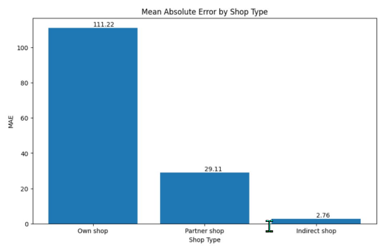
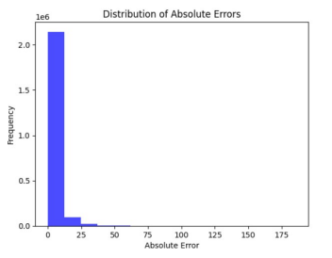
5. Results Base Models
Performed well with precipitation dataset.
Vodafone dataset MAE – 12.58
Precipitation dataset MAE – 2.49
Both base models has same performance except the absolute error plot shows lstm model performed well with own_shop and partner_shop
Absolute errors for precipitation dataset maximum values are near to Zero.

Slide 12
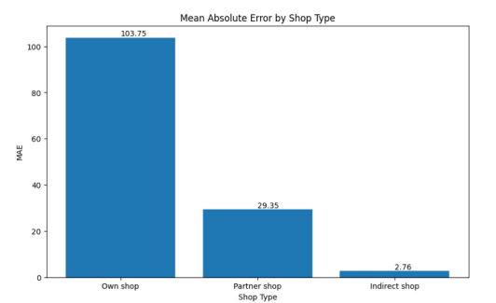
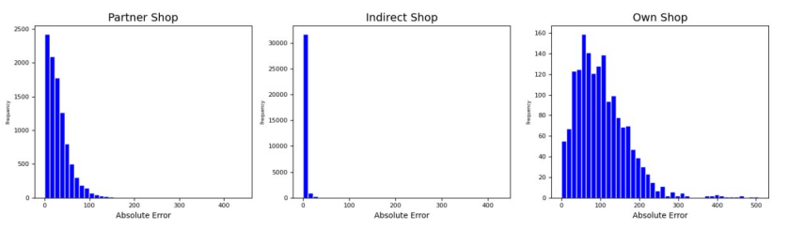
5. Results First Method (Vodafone)
Vodafone MAE – 12.3
partner_shop MAE is 103.7 lower than first and second base models
Notes:
X-axis shop types, y-axis MAE the distribution of error higher number of error values near zero

Slide 13
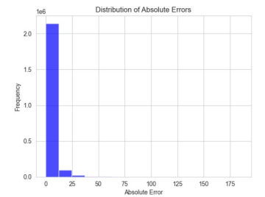
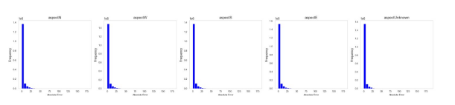
5. Results First Method (Precipitation)
Precipitation MAE – 2.4
With precipitation dataset the performance is similar to base models
Notes:
Same results..BREATH AND SLOW DOWN

Slide 14
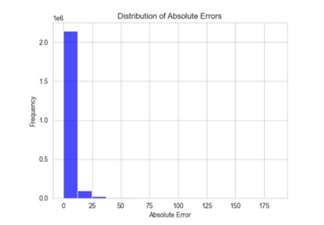
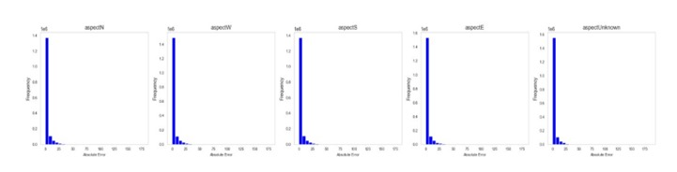
5. Results Second Method
Similar MAE of 2.7
Similar performance like first and second base model.

Slide 15
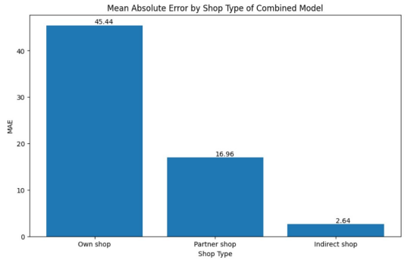
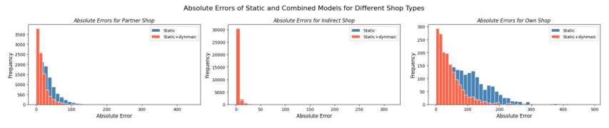
5. Results Third Method (Vodafone)
For Vodafone – Hybrid model MAE – 7.3, static model - 14.8, dynamic model – 15.9
Performed very well with Vodafone dataset

Slide 16
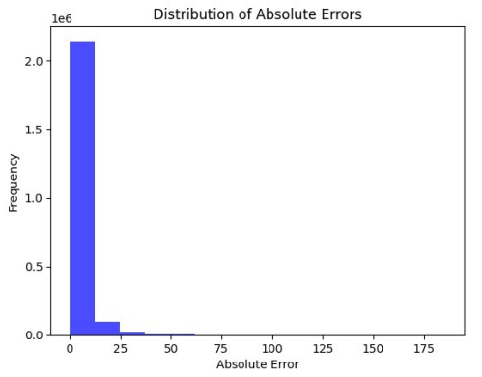
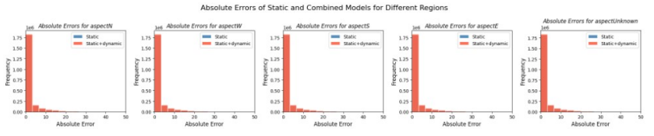
5. Results Third Method (Precipitation)
Same performance like other models
Hybrid model MAE – 2.4, static model – 2.5 and dynamic model – 2.4

Slide 17
6. Summary
Effectiveness of autoencoder depends on the number of dynamic features and encoding dimension of encoder.
Number of static and dynamic features affects the performance.
One-size fits all approach may not be effective.
Notes:
This implies that the encoding dimension was too limited to capture the essential information of the dynamic features. Conversely, with the Vodafone dataset 7 dynamic features, expanding them into an 8 dimensional space did not lead to information loss and Results 35 may have allowed the autoencoder to capture a beneficial transformation of the data. This transformation helped the autoencoder in identifying more significant patterns, thus improving the performance of the keras sequential model. SLOW DOWN
The dimensionality reduction can help in faster computation and less memory usage. Along with capturing the intrinsic structure of the data, which are important for understanding the data better, this approach provides competitive results without the loss of any valuable information. This shows the importance of dataset-specific characteristics in model architecture. The fact that the hybrid model improved performance in a dataset with a higher number of static features and was less effective in a dataset with a more balanced feature distribution shows the necessity of adopting different strategies for handling various types of features depending on their distinct roles and influences within different datasets.

Slide 18
7. Future Research
Finding suitable encoding dimension size for transforming data into an encoded form.
Improving how different types of data work together in models.
Exploring static and dynamic data combining methods on various types of data.

Slide 19
Thank you!

